Slide 1
APPLIED MACHINE LEARNING PRESENTATION TP3
David Baur
Kathleen Jones
Frederike Dümbgen
18.12.2015

Slide 2
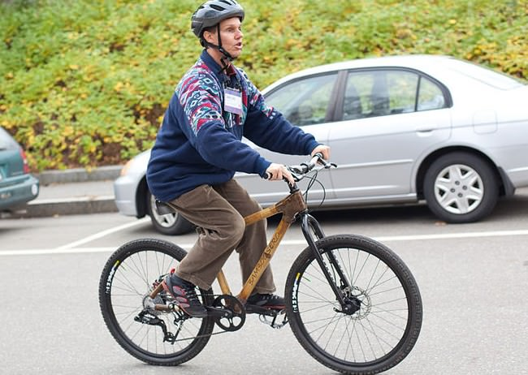
INTRODUCTION USING ECHOES FOR LOCALIZATION
^{[1]}
„The sense of imagery is very rich for an experienced user. One can get a sense of beauty or starkness or whatever“ ^{[2]}
Daniel Kish, founder of World Access for the blind
Notes:
0:53 The boy who sees without eyes
https://www.youtube.com/watch?v=TeFRkAYb1uk

Slide 3
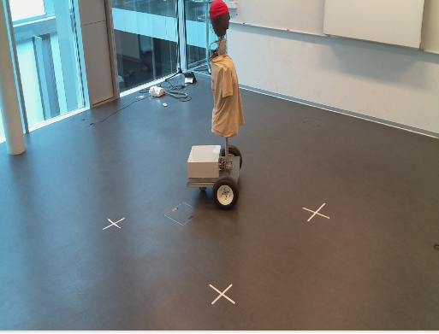
INTRODUCTION USING ECHOES FOR LOCALIZATION
Notes:
0:53 The boy who sees without eyes
https://www.youtube.com/watch?v=TeFRkAYb1uk

Slide 4
INTRODUCTION ACOUSTIC-BASED SLAM
x
y

Slide 5

INTRODUCTION ACOUSTIC-BASED SLAM
x
y

Slide 6
INTRODUCTION ACOUSTIC-BASED SLAM
x
y

Slide 7
INTRODUCTION ACOUSTIC-BASED SLAM
x
y

Slide 8
INTRODUCTION ACOUSTIC-BASED SLAM
x
y

Slide 9
INTRODUCTION ACOUSTIC-BASED SLAM
x
y

Slide 10
INTRODUCTION ACOUSTIC-BASED SLAM
x
y

Slide 11
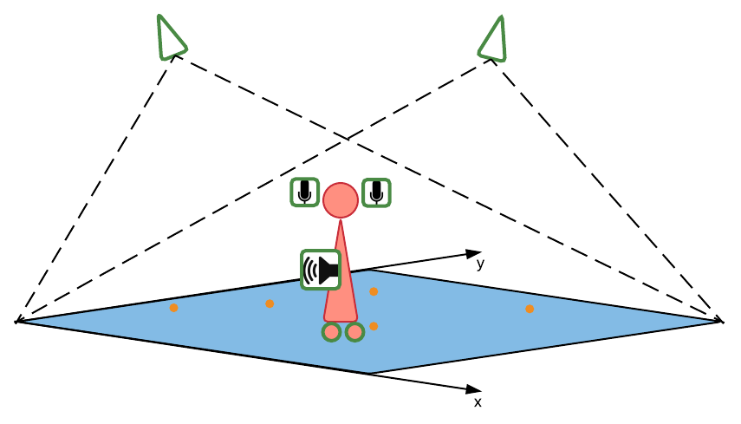
PROJECT DESCRIPTION OVERVIEW
Physical setup
Algorithms
Visual localization
ground truth
Odometry
position guess
Sound processing
new algorithm

Slide 12

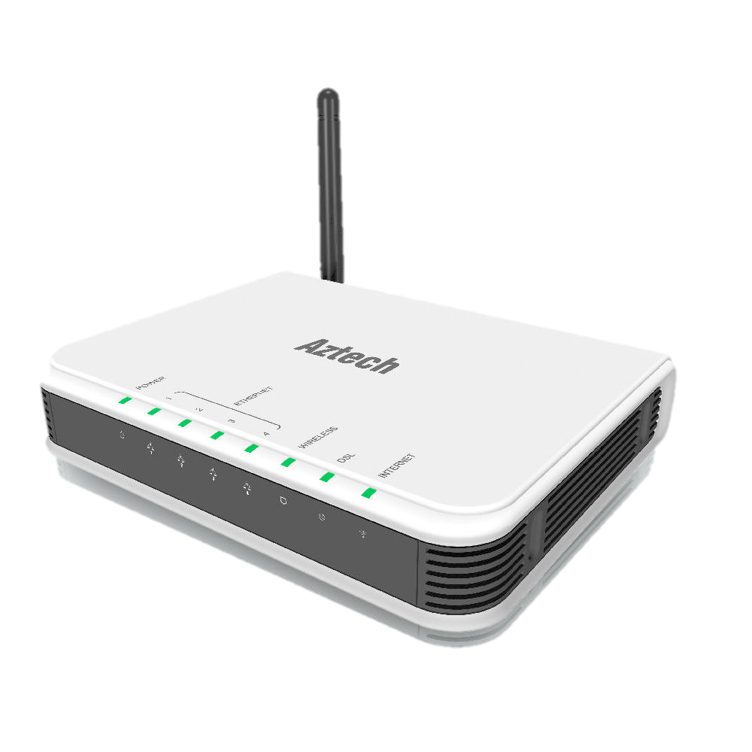
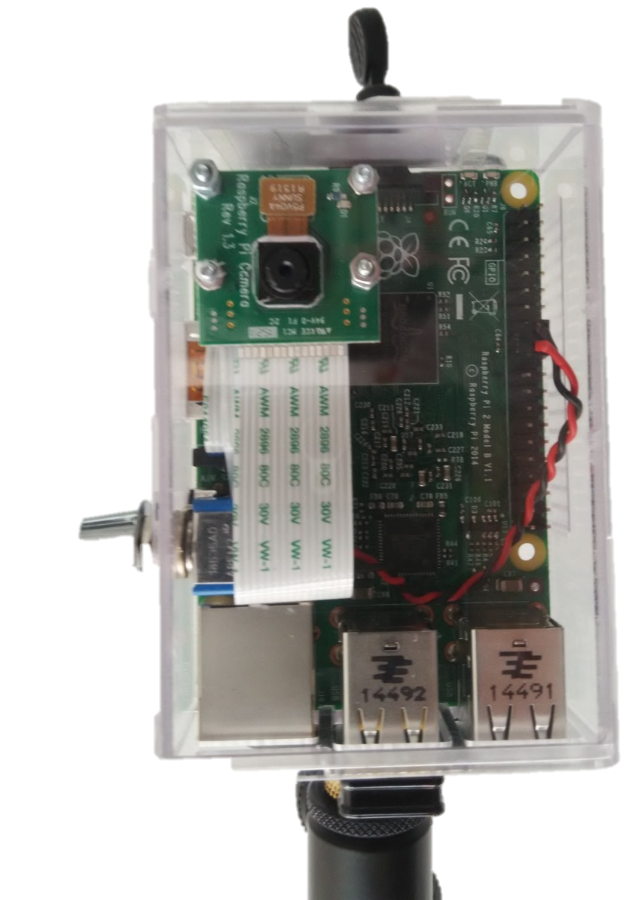
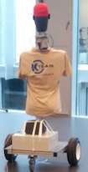
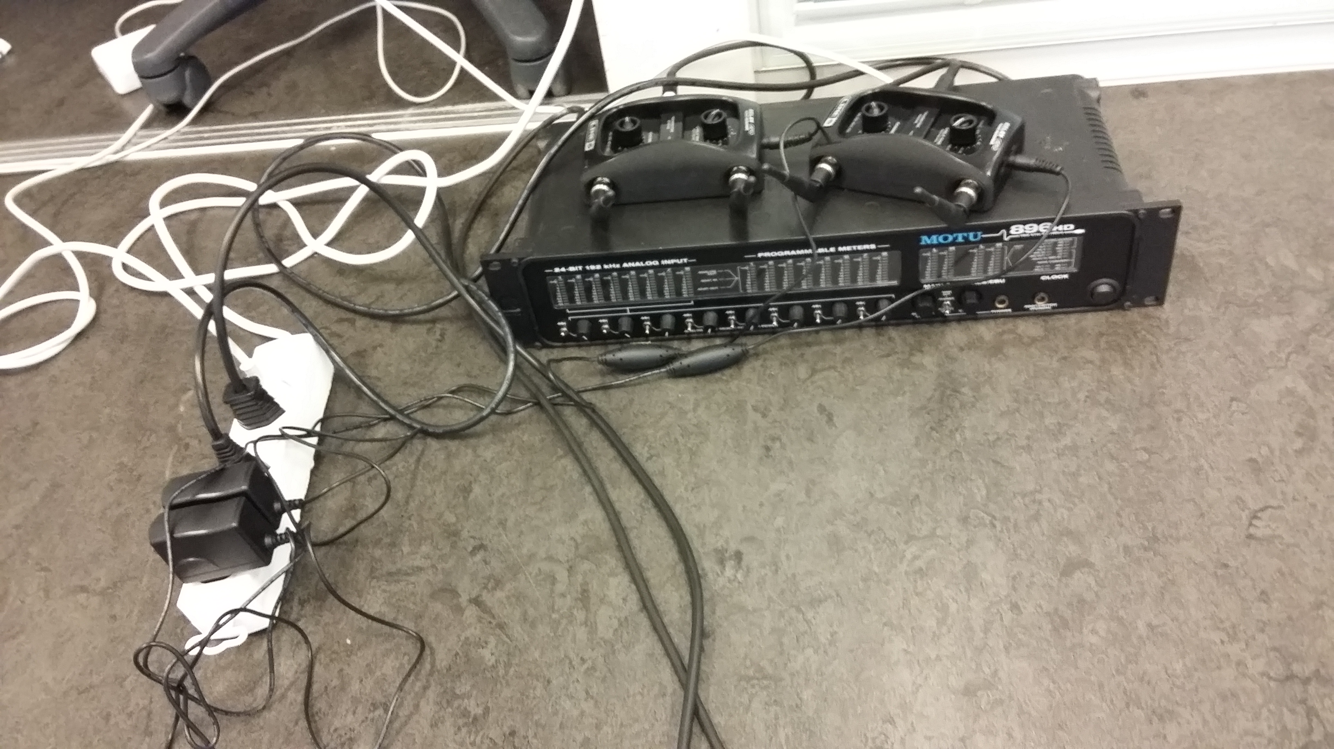
PROJECT DESCRIPTION PHYSICAL SETUP

Slide 13
PROJECT DESCRIPTION OVERVIEW
Physical setup
Algorithms
Visual localization
ground truth
Odometry
position guess
Sound processing
new algorithm

Slide 14
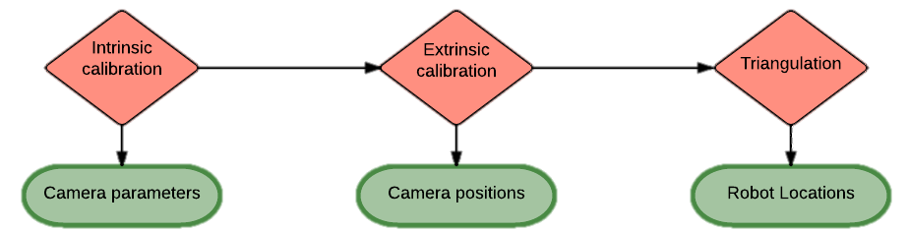
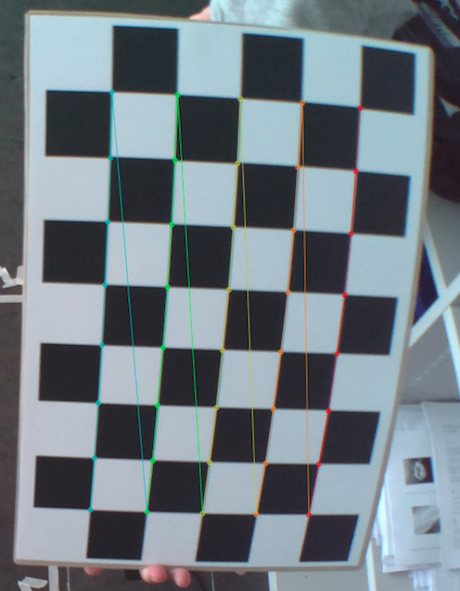
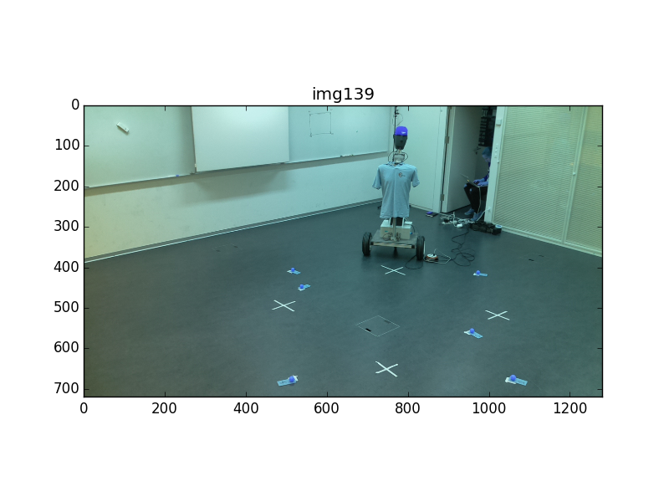
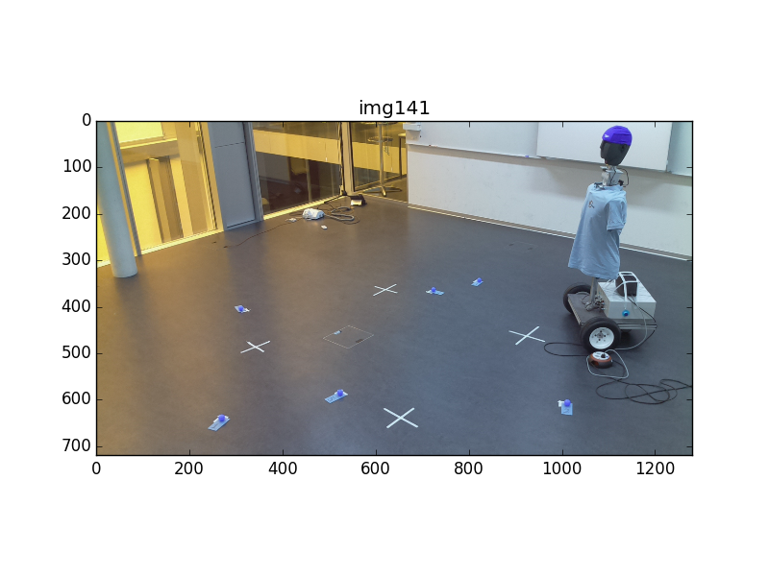
VISUAL LOCALIZATION IMPLEMENTATION

Slide 15
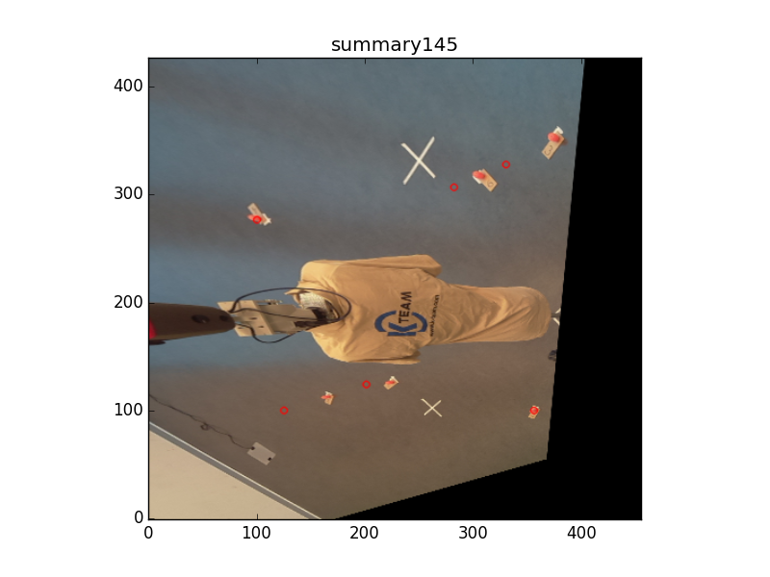
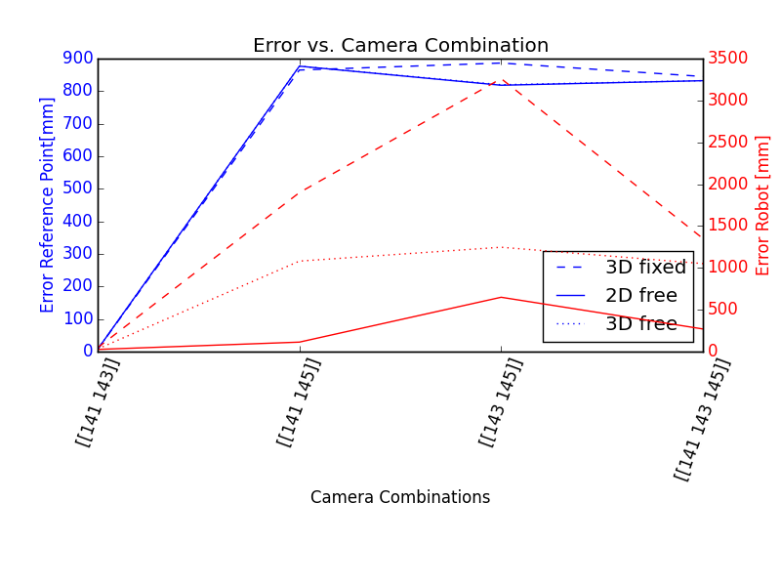
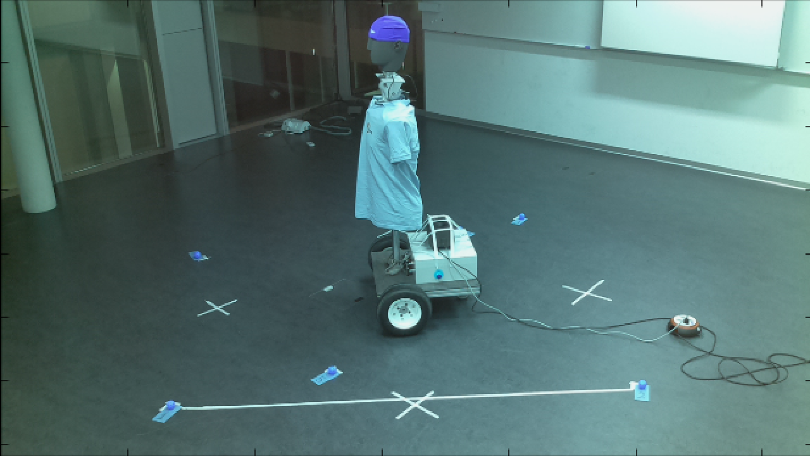
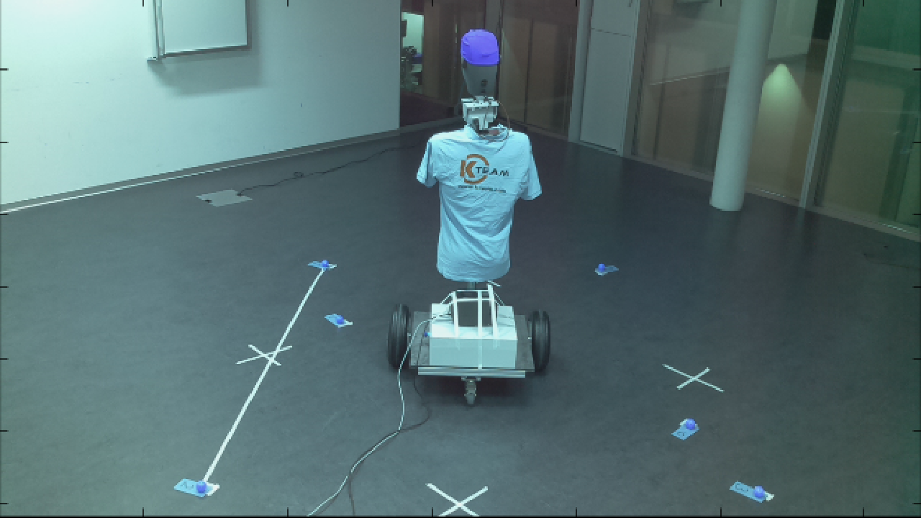
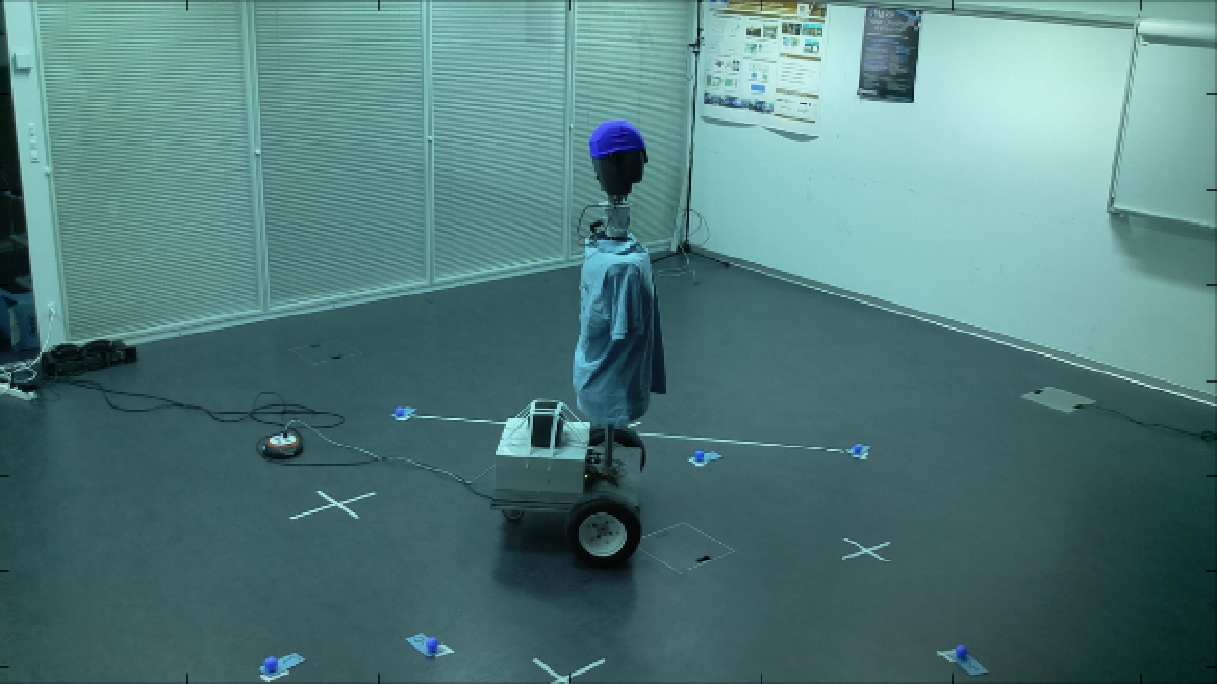
VISUAL LOCALIZATION EXPERIMENTAL RESULTS
Good accuracy in 2D (<3 cm) and height (<2 cm) for some camera combinations
Very big variance between and within 4 cameras needs more investigation
2.3 m
Notes:
Best combination (based on best 3D error with free height):[[141 143]],error: 7.1230
Fixed height [mm]: [2404.9351 , 1936.1593 , 1650.0000], error 2D: 45.96 3D: 45.96
Free height [mm]: [2401.6546 , 1971.9319 , 1632.8326], error 2D: 26.00 3D: 31.16
Real position [mm]:[2375.6553 , 1971.5825 , 1650.0000]
Error reference points [px]: [[ 22.4882 1.3184 645.2068]]

Slide 16
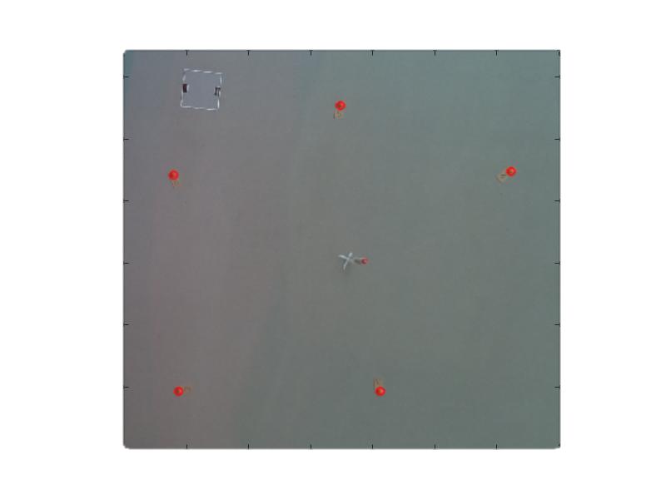
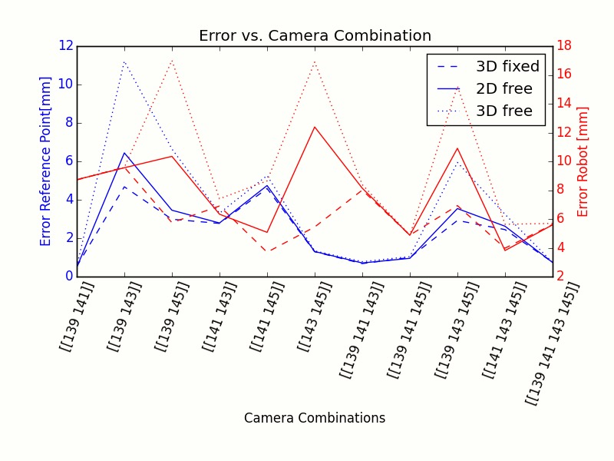
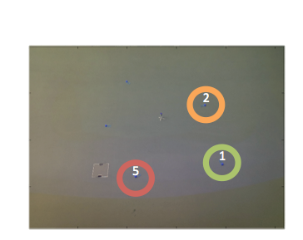
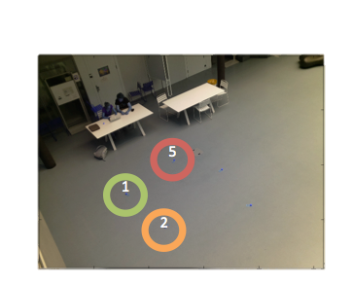
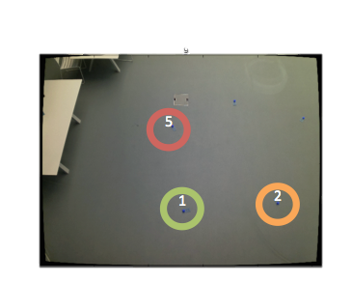
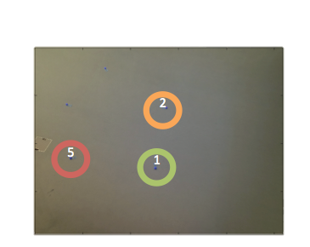
VISUAL LOCALIZATION COMPARISON ATRIUM
Very good accuracy in 2D (<1 cm) and height (<5mm) for all camera combinations
1.5 m

Slide 17
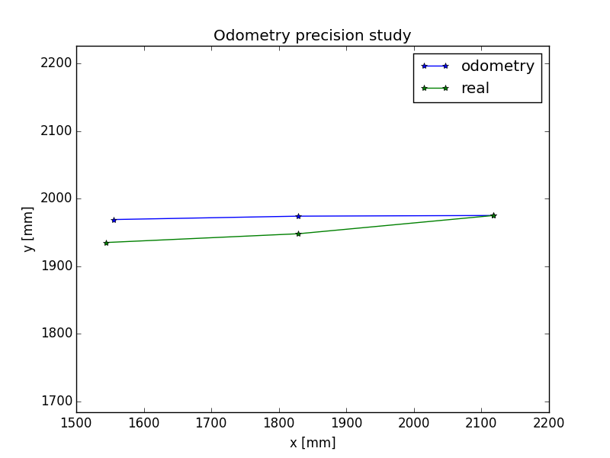
ODOMETRY EXPERIMENTAL RESULTS
3-4 cm error
Parameters:
R=15cm
D=71cm
N=512x47 counts/rev
(x₀, y₀, θ₀)
Δ_{left,k}, Δ_{right,k} (k=0,..)
Initial set off

Slide 18
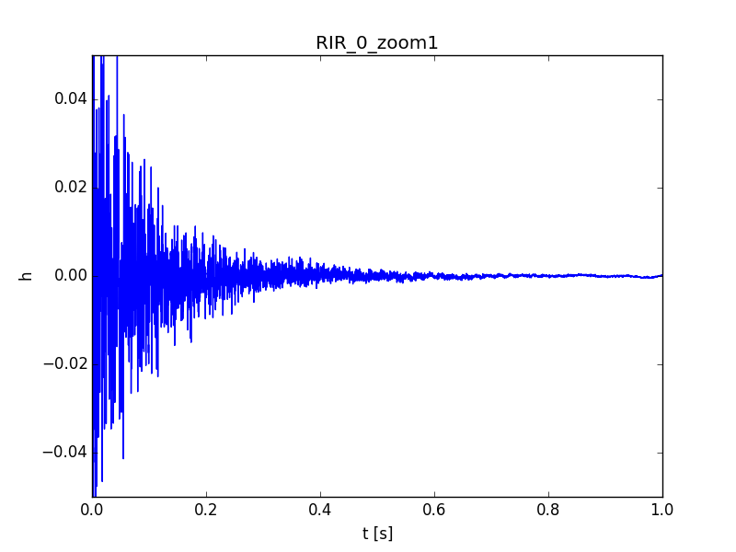
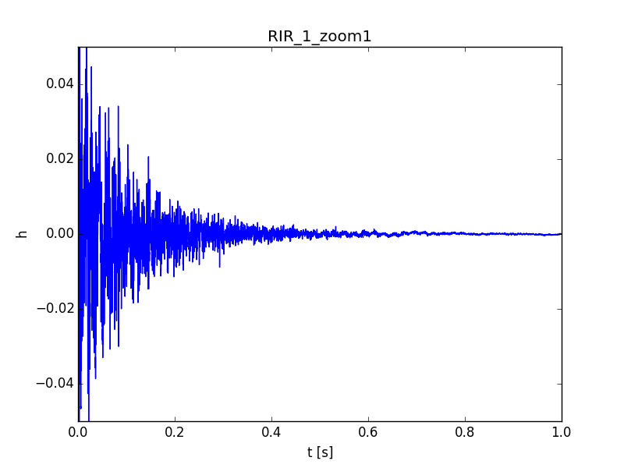
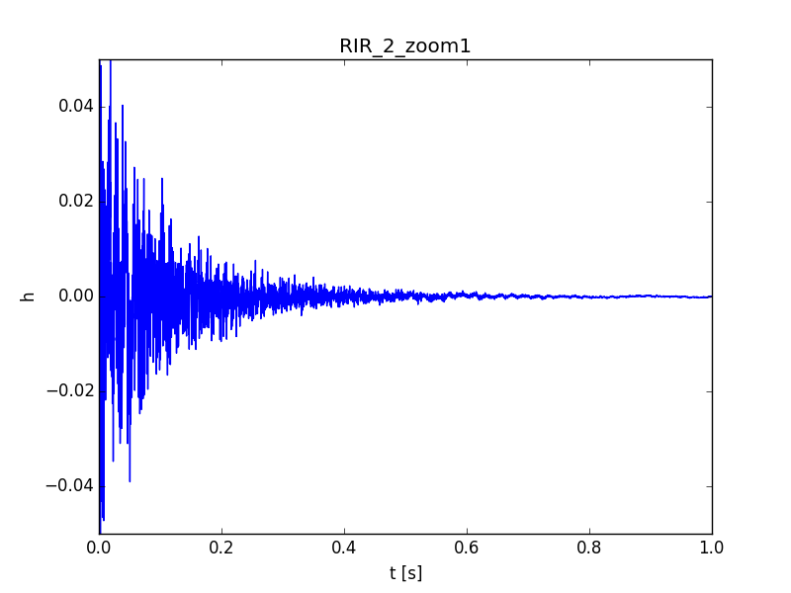
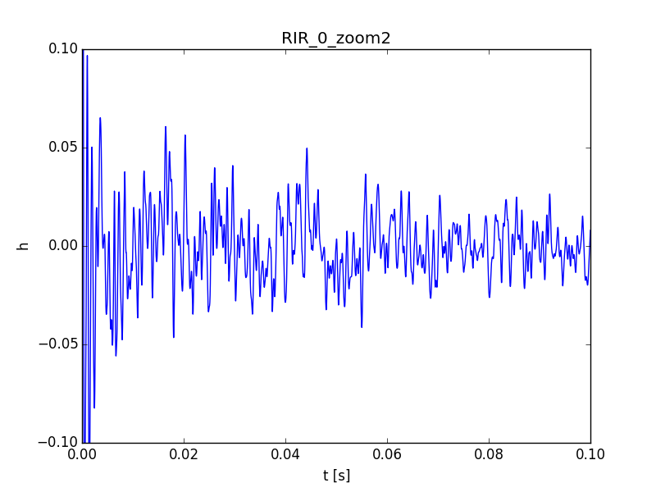
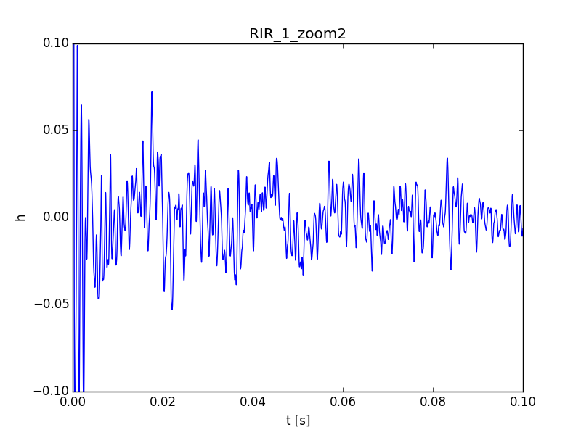
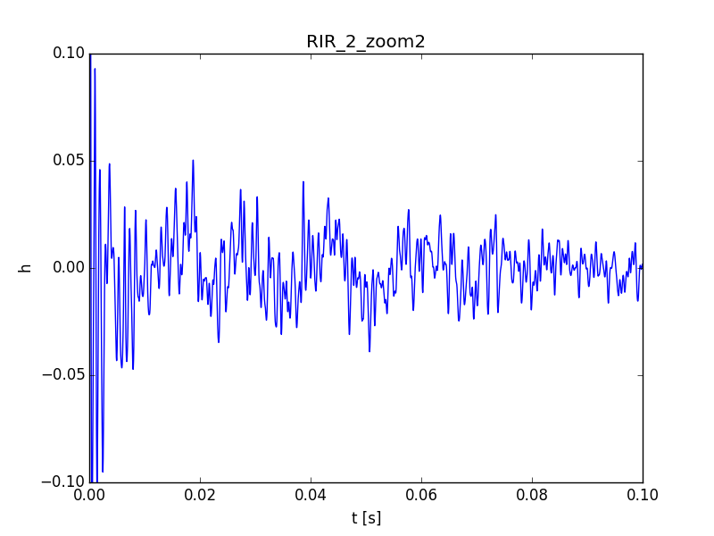
ACOUSTICS EXPERIMENTAL RESULTS

Slide 19

SUMMARY AND OUTLOOK
Physical setup
Algorithms
Visual localization
ground truth
Odometry
position guess
Sound processing
new algorithm
+ Finalization Instructions online

Slide 20
REFERENCES
[1] http://www.trailblazercoaching.com/2156/blind-batman/
[2] William Kremer: Human echolocation: Using tongue-clicks to navigate the world. 12.09.2012. www.bbc.com/news/magazine-19524962
[3] The boy who sees without eyes, 30.05.2012https://www.youtube.com/watch?v=TeFRkAYb1uk

Slide 21
Thank you

